Slide 1
Linear Regression with multiple variables
Module 3: Regression with multiple variables
Multiple Features

Slide 2
Content
Gradient Descent in practice
Feature Scaling
Checking Gradient Descent for Convergence
Choosing the Learning Rate
Optional Lab: Feature Scaling and Learning rate
Feature Engineering
Polynomial Regression
Optional Lab: Feature engineering and Polynomial Regression
Optional Lab: Linear regression with Scikit-learn
Multiple Linear Regression
Multiple Features
Vectorization
Optional Lab: Python, NumPy and Vectorization
Gradient Descent for Multiple Regression
Optional Lab: Multiple Linear Regression
Practical Quiz: Multiple Linear Regression

Slide 3
What is this module is all about ...
In this Module, you'll extend linear regression from single input to multiple input features.
You'll also learn some methods for improving your model's training and performance, such as vectorization, feature scaling, feature engineering and polynomial regression.
At the end of the module, you'll get to practice implementing linear regression using python.

Slide 4
Multiple Features (variables)

Slide 5




Multiple features (variables) is an extension of single feature regression
Size in feet² (𝑥) Price ($) in 1000’s (𝑦)
Output
(Label)
2104 | 400
1416 | 232
1534 | 315
852 | 178
… | …
^{𝑓}𝑤,𝑏
𝑥 = 𝑤𝑥 + 𝑏
Uptill now we have discussed a regression model with only single input variabe,
in this module we will introduce a regression model with multiple input variables

Slide 6














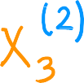



Multiple features (variables)
 | Size in feet² | Number of bedrooms | Number of floors | Age of home in years |  | Price ($) in $1000’s
 | 2104 | 5 | 1 | 45 |  | 460 232 315 178 …
 | 1416 | 3 | 2 | 40
 | 1534 | 3 | 2 | 30
 | 852 | 2 | 1 | 36
 | … | … | … | …
x_{𝑗} = 𝑗^{𝑡ℎ} feature j = 1 , ...., 4, n = 4
𝑛 = number of features
_{x} 𝑖
this is 3rd value of
the 2nd training
example, of the
3rd feature X3
= features of 𝑖^{𝑡ℎ} training example
= value of feature 𝑗 in 𝑖^{𝑡ℎ} training example
_{x} 𝑖
𝑗

Slide 7













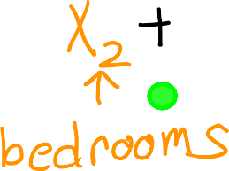
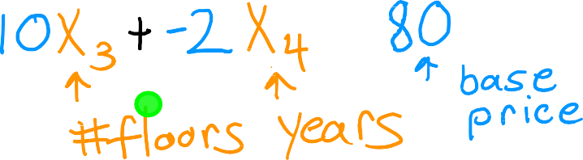

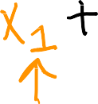





Model with Multiple Features
Previously: 𝑓_{𝑤,𝑏}
𝑥 = 𝑤𝑥 + 𝑏
single feature x
General Model
Example
^{𝑓}𝑤,𝑏
x = 𝑤₁𝑥₁ + 𝑤₂𝑥₂ + ⋯ + 𝑤_{𝑛}𝑥_{𝑛} + 𝑏

Slide 8
How to interprete coefficients
Y=80+w₁​⋅X1 ​+ w₂​⋅X₂ ​+ w₃​⋅X₃​ + w₄​⋅X₄​
Estimated Price=80 + w₁​⋅Size + w₂​⋅Bedrooms + w₃​⋅Floors + w4​⋅Age
Estimated Price=80 + 0.1​⋅Size + 4​⋅Bedrooms + 10​⋅Floors + -2​⋅Age
Size: The unit for the coefficient 0.1 would be $100 (dollars) per square foot.
Number of Bedrooms: The unit for the coefficient 4 would be 4x1000 (dollars) per additional bedroom.
Number of Floors: The unit for the coefficient 10 would be 10X $1000 (dollars) per additional floor.
House Age : The unit for the coefficient −2 would be -2x$1000 (dollars) per additional year of age.

Slide 9
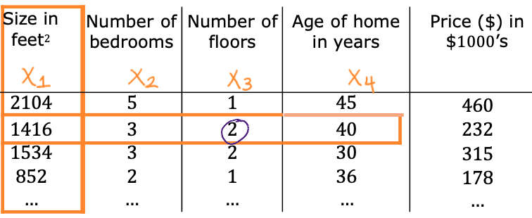
Question:
In the training set below, what is x₁⁽⁴⁾,​ x₃⁽³⁾, x₅⁽¹⁾, x₂⁽²⁾

Slide 10





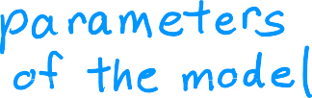



















^{𝑓}w,𝑏(x) = 𝑤₁𝑥₁ + 𝑤₂𝑥₂ +⋯ + 𝑤_{𝑛}𝑥_{𝑛} + 𝑏
Multiple linear regression model expression (Vector Notation)
(Vector)
So the model can be written as
^{𝑓}w,𝑏
x = w ∙ x + 𝑏 =
Multiple Linear Regression

Slide 11
Vectorization Part 1

Slide 12
What is Vectorization
Vectorization in multivariate regression involves using mathematical operations on entire sets of data at once, taking advantage of linear algebra principles. Instead of individually processing each data point and feature in loops.
Vectorization allows for efficient computations by operating on matrices as a whole.
This approach improves computational speed and is particularly useful for handling large datasets in machine learning, making the code more concise and leveraging optimized, hardware-accelerated operations on matrices.

Slide 13
Benefits of vectorization
Benefit | Description
Computational Efficiency | Vectorization significantly reduces computation time by processing multiple data points simultaneously.
Scalability | Vectorized algorithms can handle large datasets effectively, making them scalable to real-world applications.
Simplicity | Vectorized code is often more concise and easier to understand compared to iterative code.

Slide 14







Parameters and features with vectorization
for n = 3
w =
𝑤₁ 𝑤₂ 𝑤₃
x =
𝑥₁ 𝑥₂ 𝑥₃
𝑏 is a number
linear algebra: count from 1
w = np.array([1.0,2.5,-3.3]) b = 4
x = np.array([10,20,30])
code: count from 0
Python Linear algebra library
Andrew Ng

Slide 15

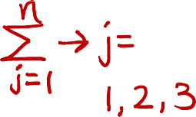




Without vectorization vs. with Vectorization
No vectorization For loop
no vectorization Direct multiplication
range (0,n) = 0, 1, 2, 3, ... n-1
^{𝑓}w,𝑏
x = 𝑤₁𝑥₁ + 𝑤₂𝑥₂ + 𝑤₃ 𝑥₃ + 𝑏
f = 0
for j in range(0,n):
f = f + w[j] * x[j]
f = f + b
f = w[0] | * x[0] | +
w[1] | * x[1] | +
w[2] | * x[2] | + b
with Vectorization
^{𝑓}w,𝑏
x = w ∙ x + 𝑏
np library uses parallel processing
f = np.dot(w,x) + b
Andrew Ng

Slide 16
Question
Which of the following is a vectorized implementation for computing a linear regression model’s prediction?
f = np.dot(w,x) + b
f=0
For j in range(n):
f = f + w[j] * x[j]
f=f + b

Slide 17
To conclude ...
Vectorization is a critical technique that makes your code simpler, easier to write and to read and it runs much faster
But what is the magic behind vectorization that makes it run so much faster ???
lets see in the next section what computers do behind the seens to make computers run much faster

Slide 18
Implementing Vectorization
The secret that makes vectorization make computers run faster

Slide 19


Without vectorization for loop
Vectorization
np.dot(w,x)
for j in range(0,16):
f = f + w[j] * x[j]
𝑡₀ (process done at one time
𝑡₀ (operates on the 1st term
w[0] | w[1] | … | w[15]
*
*
…
*
f + w[0] * x[0]
x[0] | x[1] | … | x[15]
𝑡₁
f + w[1] * x[1]
𝑡₁
…
w[0]*x[0]
+
w[1]*x[1]
+… +
w[15]*x[15]
^{𝑡}15
f + w[15] * x[15]
Vectorization: efficient calculation and scale to large data set

Slide 20


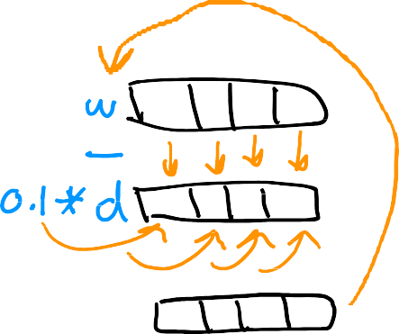
Gradient descent with vectorization
w = 𝑤₁ 𝑤₂ ⋯
d = 𝑑₁ 𝑑₂ ⋯
^{𝑤}16
^{𝑑}16
Derivatives
Store values
in arrays
w = np.array([0.5, 1.3, … 3.4])
d = np.array([0.3, 0.2, … 0.4])
coefficients
derivatives
compute (update)
𝑤_{𝑗} = 𝑤_{𝑗} − 0.1𝑑_{𝑗} for 𝑗 = 1 … 16
learning rate
Without vectorization
𝑤₁ = 𝑤₁ − 0.1𝑑₁
𝑤₂ = 𝑤₂ − 0.1𝑑₂
⋮
𝑤₁₆ = 𝑤₁₆ − 0.1𝑑₁₆
With vectorization
w = w − 0.1d
update
.
.
.
do the calculation
at the same time
for j in range(0,16):
w[j] = w[j] - 0.1 * d[j]
w = w – 0.1 * d

Slide 21
Question
Which of the following is a vectorized implementation for computing a linear regression model’s prediction?
f = np.dot(w,x) + b
f = w[0] * x[0] + w[1] * x[1] + w[2] * x[2] + b
f = 0
for j in range(n):
f = f + w[j] * x[j]
f = f + b

Slide 22
To conclude ...
You've learned one of the most important and useful techniques in implementing machine learning algorithms.
In the next section, we'll put the math of multiple linear regression together with vectorization, so that you will influence gradient descent for multiple linear regression with vectorization.
Let's go on to the next section.

Slide 23
Gradient Descent for Multiple Regression
With Vectorization
You've learned about gradient descents about multiple linear regression and also vectorization.
Let's put it all together to implement gradient descent for
multiple linear regression with vectorization.

Slide 24
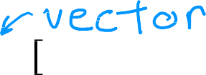








Vector notation
Previous notation
𝑤₁ , ⋯ , 𝑤_{𝑛}
𝑤₁ ⋯ 𝑤_{𝑛}
x = w ∙ x + 𝑏
Parameters
w =
𝑏
^{𝑓}w,𝑏
𝑏
Model ^{𝑓}w,𝑏
x = 𝑤₁ 𝑥₁ + ⋯ + 𝑤_{𝑛}𝑥_{𝑛} + 𝑏
𝐽 ( 𝑤₁, ⋯ , 𝑤_{𝑛}, 𝑏)
Cost function
𝐽 w, 𝑏
Gradient descent
repeat {
repeat {
𝑤_{𝑗} = 𝑤_{𝑗} − 𝛼 𝜕 𝐽 (𝑤₁, ⋯ , 𝑤_{𝑛,}b)
𝑤 = 𝑤_{𝑗} − 𝛼 𝜕 𝐽 w, 𝑏
𝑗
𝜕𝑤_{𝑗}
𝜕𝑤_{𝑗}
𝑏 = 𝑏 − 𝛼 𝜕 𝐽 𝑤₁, ⋯ , 𝑤_{𝑛}, 𝑏
𝑏 = 𝑏 − 𝛼 𝜕 𝐽 w, 𝑏
$$∂b$$
$$∂b$$
}
}

Slide 25

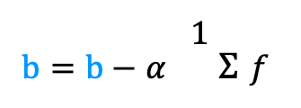
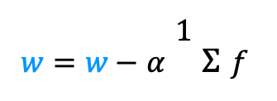
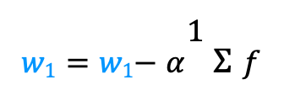
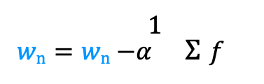
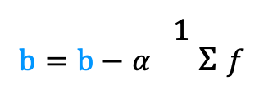
Gradient descent
One feature
𝑛 features
𝑛 ≥ 2
repeat {
repeat {
1
𝑤 = 𝑤 − 𝛼 $Σ$𝑓
j = 1
𝑚
_{𝑥} 𝑖
_{𝑥} 𝑖
− 𝑦 ^{𝑖}
1
𝑤₁ = 𝑤₁− 𝛼 $Σ$𝑓
𝑚
𝑤,𝑏
𝑚
_{𝑥} 𝑖
_{𝑥} 𝑖
𝑖=1
− 𝑦 ^{𝑖}
𝑚
𝑤,𝑏
.
.
𝑖=1
𝜕
_{𝜕𝑤} 𝐽 𝑤, 𝑏
𝜕
_{𝜕𝑤1} 𝐽 𝑤, 𝑏
1
𝑤_{n} = 𝑤_{n} −𝛼 $Σ$𝑓
𝑚
_{𝑥} 𝑖
_{𝑥} 𝑖
− 𝑦 ^{𝑖}
𝑚
𝑤,𝑏
𝑖=1
1
b = b − 𝛼 $Σ$𝑓
𝑚
_{𝑥} 𝑖
− 𝑦 ^{𝑖}
𝑚
𝑤,𝑏
𝑖=1
1
b = b − 𝛼 $Σ$𝑓
𝑚
_{𝑥} 𝑖
− 𝑦 ^{𝑖}
𝑚
𝑤,𝑏
simultaneously update 𝑤, 𝑏
𝑖=1
}
}
simultaneous update
w_{j} for j = 1 ... n) and b

Slide 26
An alternative to gradient descent
Normal equation
Only for linear regression
Solve for w, b without
iterations
Disadvantages
Doesn’t generalize to other
learning algorithms.
Slow when number of features is large (> 10,000)
What you need to know
Normal equation method may be used in machine learning libraries that implement linear regression.
Gradient descent is the
recommended method for finding parameters w,b

Slide 27
To conclude ...
You now know multiple linear regression.
This is probably the single most widely used learning algorithm in the world today.
But there's more. With just a few tricks such as picking and scaling features appropriately and also choosing the learning rate alpha appropriately, you'd really make this work much better.
Let's go on to the next section to see those little tricks that will help you make multiple linear regression work much better.

Slide 28
Practical Tips for Linear Regression
Feature Scaling

Slide 29
Simple definiton of feature scaling
Imagine you have a dataset with two features: age and income. The age feature might range from 10 to 100, while the income feature might range from $10,000 to $1,000,000. When you train a machine learning model on this data, the model will give more weight to the income feature because it has a larger scale. This can make it difficult for the model to learn the relationship between the age feature and the target variable.
Feature scaling is a technique that can be used to normalize the features in a dataset so that they all have a similar scale. This can help to improve the performance of machine learning models.

Slide 30








Feature and parameter values
𝑥₁: size (feet²)
range: 300 − 2,000
𝑥₂: # bedrooms
range: 0 − 5
𝑝𝑟𝑖𝑐𝑒 = 𝑤₁ 𝑥₁ + 𝑤₂𝑥₂ + 𝑏
House: 𝑥₁ = 2000, 𝑥₂ = 5, 𝑝𝑟𝑖𝑐𝑒 = $500k
size of the parameters 𝑤₁ , 𝑤₂?
𝑤₁ = 50, 𝑤₂ = 0.1, 𝑏 = 50 𝑤₁ = 0.1, 𝑤₂ = 50, 𝑏 = 50
𝑝𝑟𝑖𝑐𝑒 = 50 ∗ 2000 + 0.1 ∗ 5 + 50 𝑝𝑟𝑖𝑐𝑒 = 0.1 ∗ 2000𝑘 + 50 ∗ 5 + 50
large
small
small
large
100,000 k
0.5 k
50 k
200 k
250 k
50 k
𝑝𝑟𝑖𝑐𝑒 = $100,050.5k
𝑝𝑟𝑖𝑐𝑒 = $500k
More Reasonable

Slide 31
What do we conclude
So hopefully you might notice that when a possible range of values of a feature is large, like the size and square feet which goes all the way up to 2000. It's more likely that a good model will learn to choose a relatively small parameter value, like 0.1.
Likewise, when the possible values of the feature are small, like the number of bedrooms, then a reasonable value for its parameters will be relatively large like 50.
So how is that relate to gradient Descent ...?

Slide 32

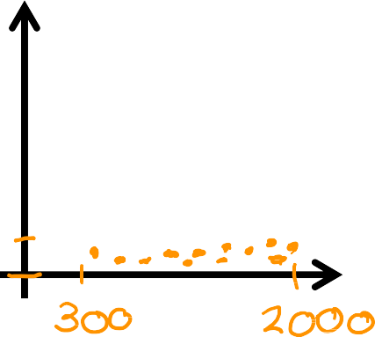
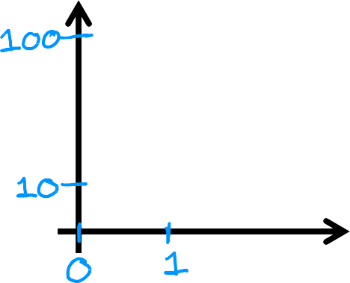
Feature size and parameter size
 | size of feature 𝑥_{𝑗} | size of parameter 𝑤_{𝑗}
size in feet²
#bedrooms
Features
Parameters
𝐽 ( w, 𝑏)
Contour plot
𝑥₂
# bedrooms
𝑤₂
# bedrooms
𝑥₁ size in feet²
𝑤₁ size in feet²

Slide 33
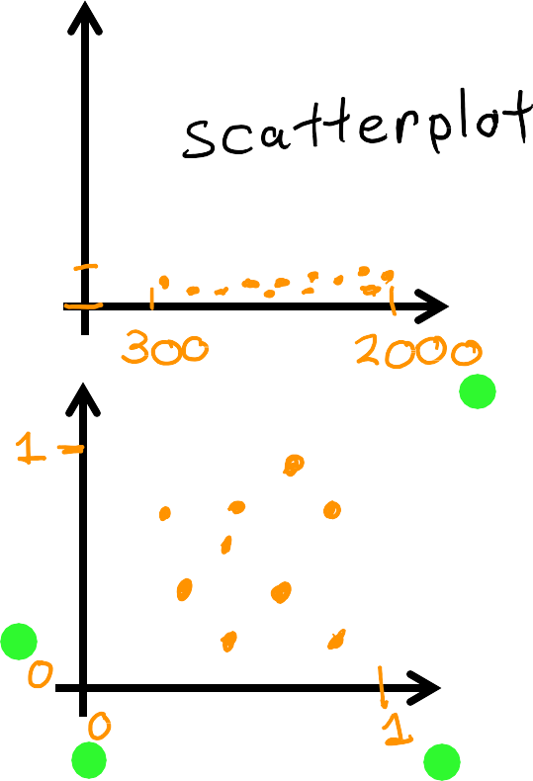
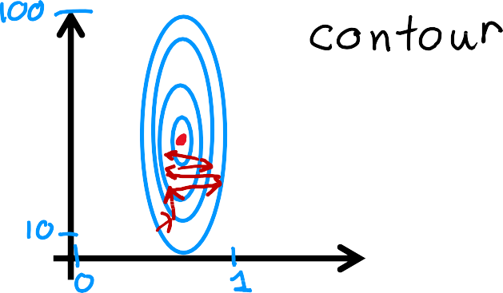

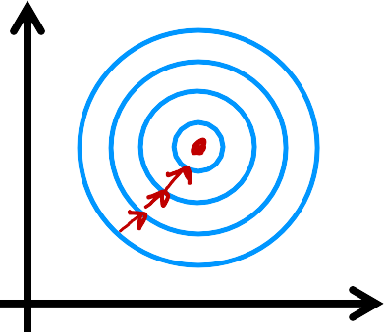
Feature size and gradient descent
Features Parameters
𝑥₂
# bedrooms
𝑤₂
# bedrooms
𝐽 w, 𝑏
𝑤₁ size in feet²
𝑥₁ size in feet²
𝑥₂
# bedrooms
rescaled
𝑤₂
# bedrooms rescaled
𝐽 w, 𝑏
𝑥₁ size in feet²
𝑤₁ size in feet²
rescaled
rescaled
The rescaled values of the parameters are taking comparable ranges to each others

Slide 34
Practical Tips for Linear Regression
How to implement Feature scaling

Slide 35
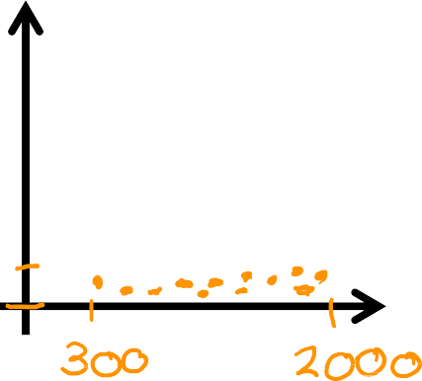




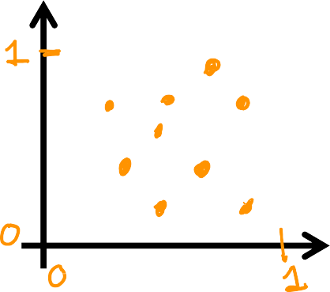



Feature scaling
𝑥₂
# bedrooms
300 ≤ 𝑥₁ ≤ 2000
0 ≤ 𝑥₂ ≤ 5
𝑥₁ size in feet²
𝑥
𝑥
₌ 1
₌ 2
𝑥
𝑥
1,𝑠𝑐𝑎𝑙𝑒𝑑
2000
2,𝑠𝑐𝑎𝑙𝑒𝑑
5
𝑥₂
# bedrooms rescaled
0.15 ≤ 𝑥_{1,𝑠𝑐𝑎𝑙𝑒𝑑} ≤ 1
^{0 ≤ 𝑥}2,𝑠𝑐𝑎𝑙𝑒𝑑 ^{≤ 1}
𝑥₁ size in
feet² rescaled

Slide 36
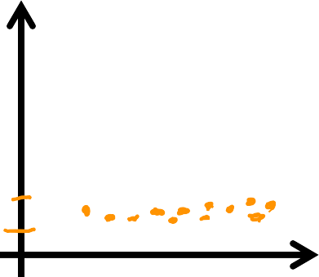








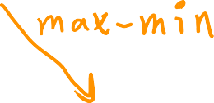
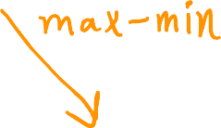




Mean normalization
300 ≤ 𝑥₁ ≤ 2000
0 ≤ 𝑥₂ ≤ 5
𝑥₂
# bedrooms
𝑥₁ − 𝜇₁
𝑥₂ − 𝜇₂
𝑥 =
𝑥 size
𝑥 =
1
in feet²
1
2000−300
2
5−0
𝑥₂
# bedrooms normalized
−0.18 ≤ 𝑥₁ ≤ 0.82
−0.46 ≤ 𝑥₂ ≤ 0.54
𝑥₁ size in feet²
normalized

Slide 37
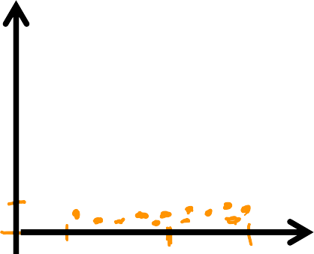

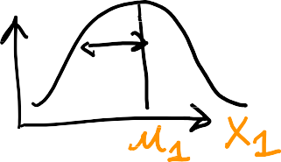










Z-score normalization
standard deviation 𝜎
300 ≤ 𝑥₁ ≤ 2000
0 ≤ 𝑥₂ ≤ 5
𝑥₂
# bedrooms
𝜎₁ = 450
𝜎₁
𝜎 = 1.4
2
𝑥₁ − 𝜇₁
𝑥 =
𝑥₂ − 𝜇₂
𝑥 =
𝑥₁ size in feet²
1
𝜎
2
𝜎₂
1
𝑥₂
# bedrooms normalized
−0.67 ≤ 𝑥₁ ≤ 3.1 −1.6 ≤ 𝑥₂ ≤ 1.9
𝑥₁ size in feet²
normalized

Slide 38
























Feature scaling
aim for about −1 ≤ 𝑥_{𝑗} ≤ 1 for each feature 𝑥_{𝑗}
−3 ≤ 𝑥_{𝑗} ≤ 3
−0.3 ≤ 𝑥_{𝑗} ≤ 0.3
0 ≤ 𝑥₁ ≤ 3
−2 ≤ 𝑥₂ ≤ 0.5
−100 ≤ 𝑥₃ ≤ 100
−0.001 ≤ 𝑥₄ ≤ 0.001
98.6 ≤ 𝑥₅ ≤ 105

Slide 39
To conclude ...
There's almost never any harm to carrying out feature re-scaling. When in doubt, I encourage you to just carry it out.
That's it for feature scaling. With this little technique, you'll often be able to get gradient descent to run much faster. That's features scaling.
With or without feature scaling, when you run gradient descent, how can you know, how can you check if gradient descent is really working?
If it is finding you the global minimum or something close to it.
In the next section, let's take a look at how to recognize if gradient descent is converging, and then in the video after that, this will lead to discussion of how to choose a good learning rate for gradient descent.

Slide 40
Checking Gradient Descent for Convergence

Slide 41

Gradient descent
𝑤_{𝑗} = 𝑤_{𝑗} − 𝛼 𝜕 𝐽 (𝑤₁, ⋯ , 𝑤_{𝑛,}b)
𝜕𝑤_{𝑗}
𝑏 = 𝑏 − 𝛼 𝜕 𝐽 𝑤₁, ⋯ , 𝑤_{𝑛}, 𝑏
$$∂b$$
these are the gradient descent algorithm equations, and one of the main choices of the parameters is the choice of alpha (a) the learning rate
So the question is how do we choose alpha

Slide 42
The number of iterations in gradient descent significantly impacts the cost function.
As the number of iterations increases, the cost function generally decreases.
The optimal number of iterations depends on various factors and may not be linear.

Slide 43
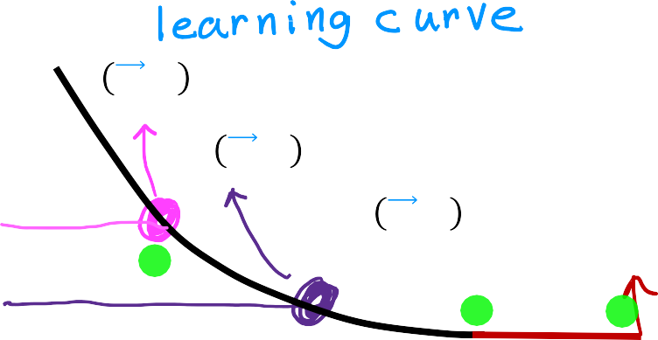
Make sure gradient descent is working correctly
objective: min 𝐽 w, 𝑏
w,𝑏
Learning Curve
𝐽 w, 𝑏
𝐽 w, 𝑏 after 100 iterations
𝐽 w, 𝑏 after 200 iterations
𝐽 w, 𝑏 likely converged by 400 iterations
0 100 200 300 400
# iterations
# iterations needed varies
𝐽 w, 𝑏 should decrease after every iteration
plot J(w,b) as a function of
number of iterations.
the cost function should
decrease constantly
if the cost function increase after
some iterations, then either alpha
is chosen poorly, or there is a bug
in the code

Slide 44
Make sure gradient descent is working correctly
Learning Curve
Automatic convergence test
𝐽 w, 𝑏
𝐽 w, 𝑏 after 100 iterations
𝐽 w, 𝑏 after 200 iterations
𝐽 w, 𝑏 likely converged by 400 iterations
0 100 200 300 400
# iterations
Let 𝜀 “epsilon” be 10⁻³.
If 𝐽 w, 𝑏 decreases by ≤ 𝜀
in one iteration, you may declare
convergence
Which means that you found parameters w and b to get close to global minimum)
Number of iterations varies for different applications, it may take 30, some other
applications might take 1000, or 10,000 iterations.
it might be difficult to tell in advance how many iterations gradient descent might
need to converge

Slide 45
to conclude ...
You've now seen what the learning curve should look like when gradient descent is running well.
Let's take these insights and in the next part, take a look at how to choose an appropriate learning rate.

Slide 46
Choosing the Learning Rate

Slide 47
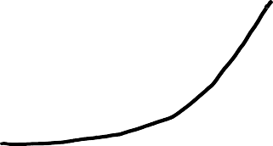




Identify problem with gradient descent
𝛼 is too large
𝐽 𝑤, 𝑏
𝐽 𝑤, 𝑏
# iterations
# iterations
𝑤₁ = 𝑤₁ + 𝛼𝑑₁
use a minus sign
𝑤₁ = 𝑤₁ − 𝛼𝑑₁
or
learning rate is too large

Slide 48
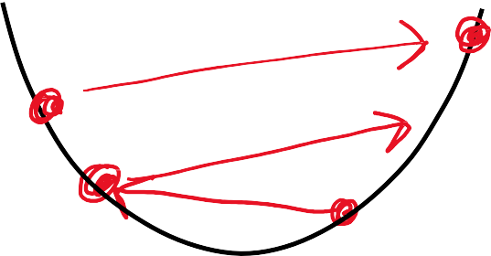
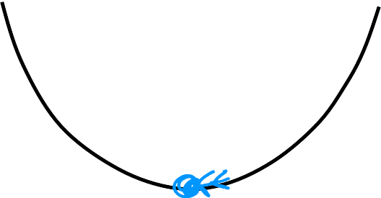
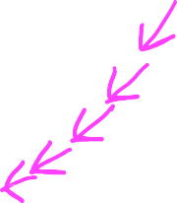



Identify problem with gradient descent
𝛼 is too large
With a small enough 𝛼,
𝐽 w, 𝑏 should decrease on every iteration
𝐽 𝑤, 𝑏
𝐽 𝑤, 𝑏
# iterations
# iterations
𝛼 is too big
Use smaller 𝛼
𝐽 𝑤, 𝑏
𝐽 𝑤, 𝑏
If 𝛼 is too small, gradient descent takes a lot more iterations to converge
parameter 𝑤₁
parameter 𝑤₁
Since alpha is big you may skip the minimum,
and that will make the cost function increases

Slide 49









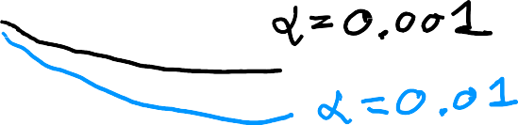
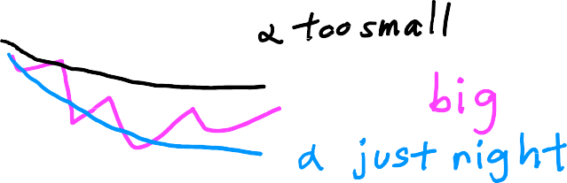

Values of 𝛼 to try:
… 0.001
0.01
0.1
1 …
J w, b
J w, b
# iterations
# iterations

Slide 50
Feature Engineering
Feature engineering is a crucial step in machine learning that involves transforming raw data into features suitable for machine learning algorithms.

Slide 51
Key objectives of feature engineering:
  Select relevant features: Identify and select the most relevant features from the dataset to eliminate noise and focus on important factors.
  Create new features: Derive new features from existing data to capture underlying relationships and patterns that may not be directly present in the raw data.
  Transform existing features: Transform existing features using techniques like scaling, normalization, and binning to improve model convergence and stabilize the training process.

Slide 52
Benefits of feature engineering:
  Improved model performance: Enhances the accuracy and generalizability of machine learning models.
  Faster model training: Reduces the complexity of data and improves model convergence.
  Better understanding of data: Reveals underlying relationships and patterns in the data, leading to more meaningful insights.

Slide 53
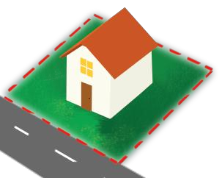
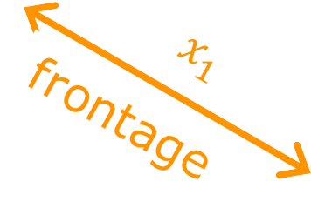


Feature engineering
^{𝑓}w,𝑏
x = 𝑤₁ 𝑥₁ + 𝑤₂ 𝑥₂ + 𝑏
frontage
depth
𝑎𝑟𝑒𝑎 = 𝑓𝑟𝑜𝑛𝑡𝑎𝑔𝑒 × 𝑑𝑒𝑝𝑡ℎ
𝑥₃ = 𝑥₁𝑥₂
Feature engineering: Using intuition to design new features, by transforming or combining original features.
^{𝑓}w,𝑏
x = 𝑤₁𝑥₁ + 𝑤₂𝑥₂ + 𝑤₃𝑥₃ + 𝑏
So by designing a new feature you migh get a better model
Andrew Ng

Slide 54
Polynomial Regression
Polynomial regression is a type of regression analysis that models the relationship between a response variable and one or more independent variables using a polynomial equation.
In other words, it assumes that the relationship between the variables can be expressed as a sum of terms, where each term is the product of a constant and a variable raised to an integer power.

Slide 55
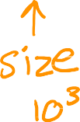

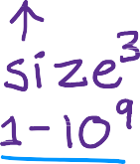
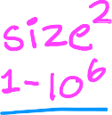






Polynomial regression
^{𝑓}𝑤,𝑏
𝑥 = 𝑤₁𝑥 + 𝑤₂𝑥² + 𝑤₃𝑥³ + 𝑏
price y
^{𝑓}𝑤,𝑏
𝑥 = 𝑤₁𝑥 + 𝑤₂𝑥² + 𝑏
size x

Slide 56
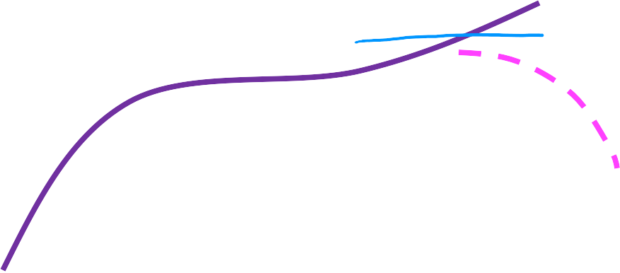











Choice of features
^{𝑓}w,𝑏
𝑥 = 𝑤₁𝑥 + 𝑤₂ 𝑥 + 𝑏
price y
size x

